Slide 1

Online course recommendation

Slide 2
Project done by:
Ajay⁩
Charan
⁩ Preetika
Digambar
Eshwar⁩
Vamsi⁩
Renuka
With The Help Of Mentor & Co'Mentor:
Diptarko
Prajwal A N

Slide 3
introduction
An online course recommendation system is an AI-powered tool designed to help learners discover relevant educational content based on their personal interests, goals, and learning history. By filtering through vast catalogs of classes, these systems prevent information overload and deliver highly personalized suggestions.
These systems utilize e-learning data to match you with the right course through a few key methods:
Content-Based Filtering: The system analyzes course metadata—such as titles, descriptions, categories, and difficulty levels—to find courses that share similar features or topics.
Collaborative Filtering: It looks at the learning habits of other students with similar profiles. If users who took the same courses as you also enjoyed a specific machine learning class, the system will recommend that class to you.
Hybrid Approaches: Most modern platforms combine both methods to improve accuracy. They often use natural language processing (NLP) to understand what a course is about and machine learning to map out personalized

Slide 4
PROBLEM STATEMENT
This project aims to develop a Hybrid Course Recommendation System that combines Collaborative Filtering and Content-Based Filtering to recommend personalized courses. The system analyzes user interactions, course features, and learner preferences to generate accurate and relevant recommendations.
The proposed system recommends courses based on:
User's previous course history
Course content and features
User ratings and feedback
Difficulty level
Course price
Certification availability
By providing personalized recommendations, the system helps learners discover the most relevant courses quickly, improves their learning experience, and increases engagement on online learning platforms.
OBJECTIVE: "The main objective of this project is to build a hybrid course recommendation system that combines Content-Based and Collaborative Filtering techniques. The system provides personalized course recommendations based on user preferences and course features, improves recommendation accuracy, addresses the cold-start problem, evaluates performance using RMSE and MAE, and is deployed through a Streamlit web application for easy user interaction."

Slide 5
METHODOLOGY OVERVIEW
PROJECT WORKFLOW
TOOLS & TECHNOLOGIES
Data Collection
Data Cleaning
Visualization
Model Building
Model Evaluation
Deployment
Python
Pandas
NumPy
Scikit –learn
Matplotlib/Seaborn
Surprise
Streamlit

Slide 6
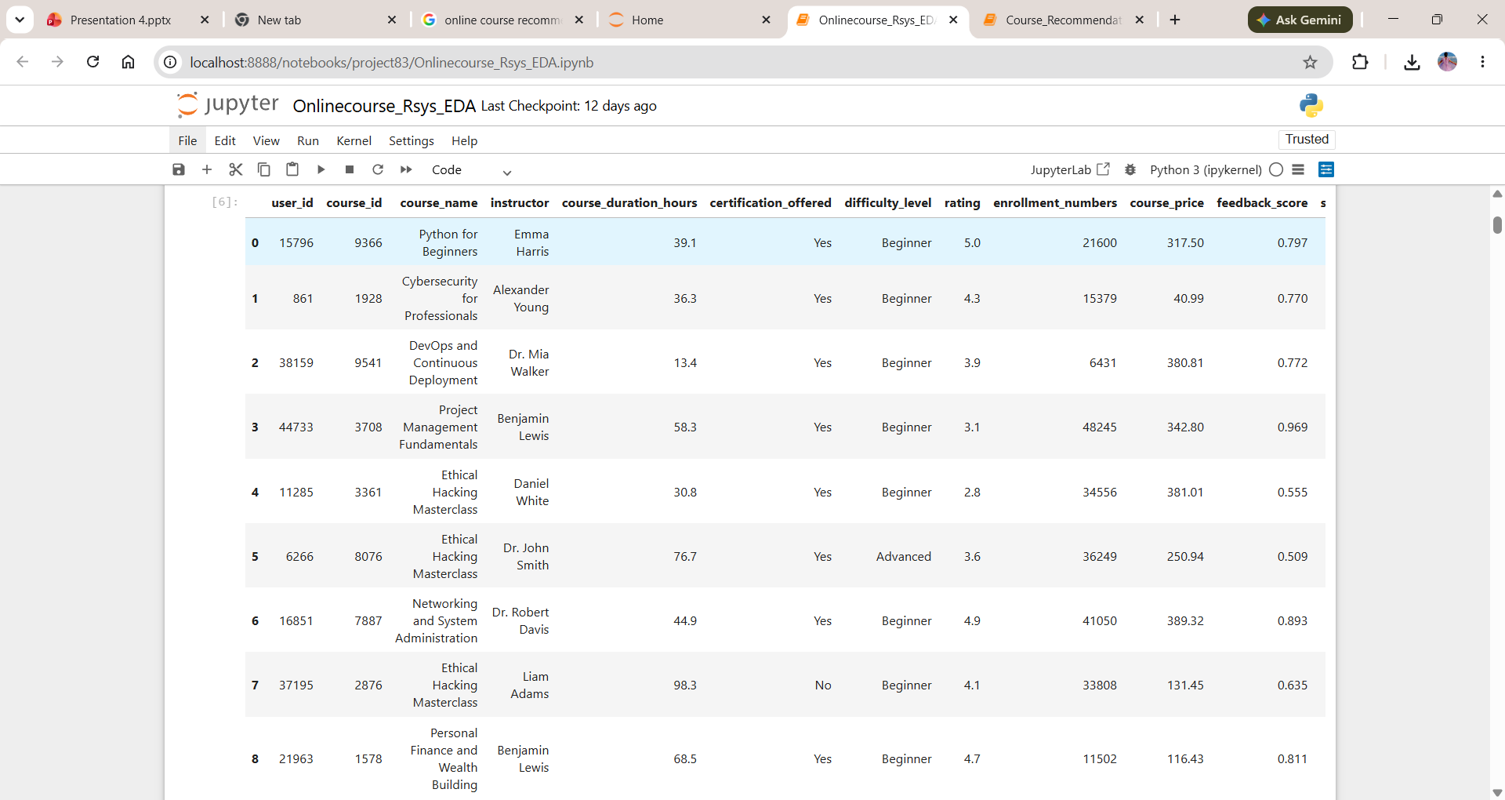
DATA cOLLECTION
Df=pd.read_excel("online_course_recommendation_V2.xlsx")
# Display first nine records
df.head(9)
#dataset Shape
print("Rows :", df.shape[0])
print("Columns :", df.shape[1])
Output:
Rows : 100000 Columns : 14

Slide 7
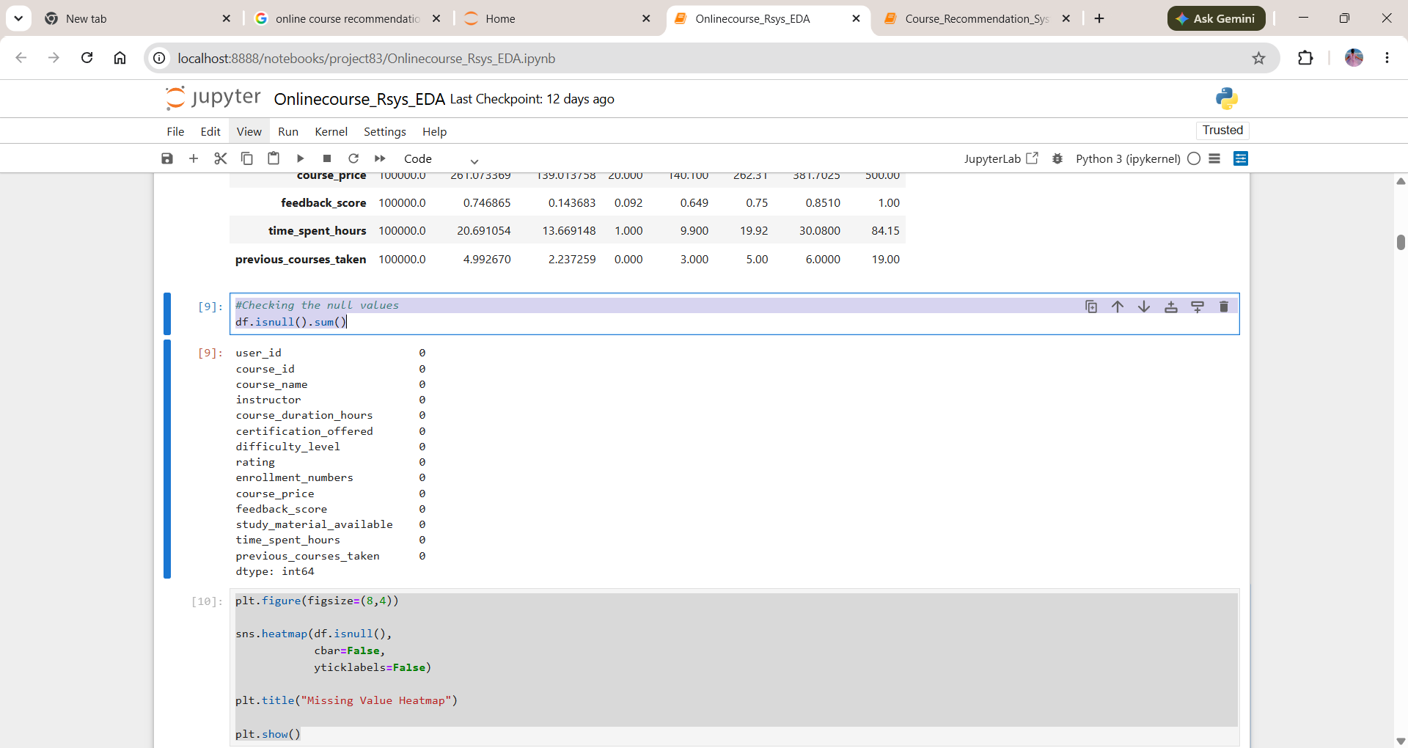
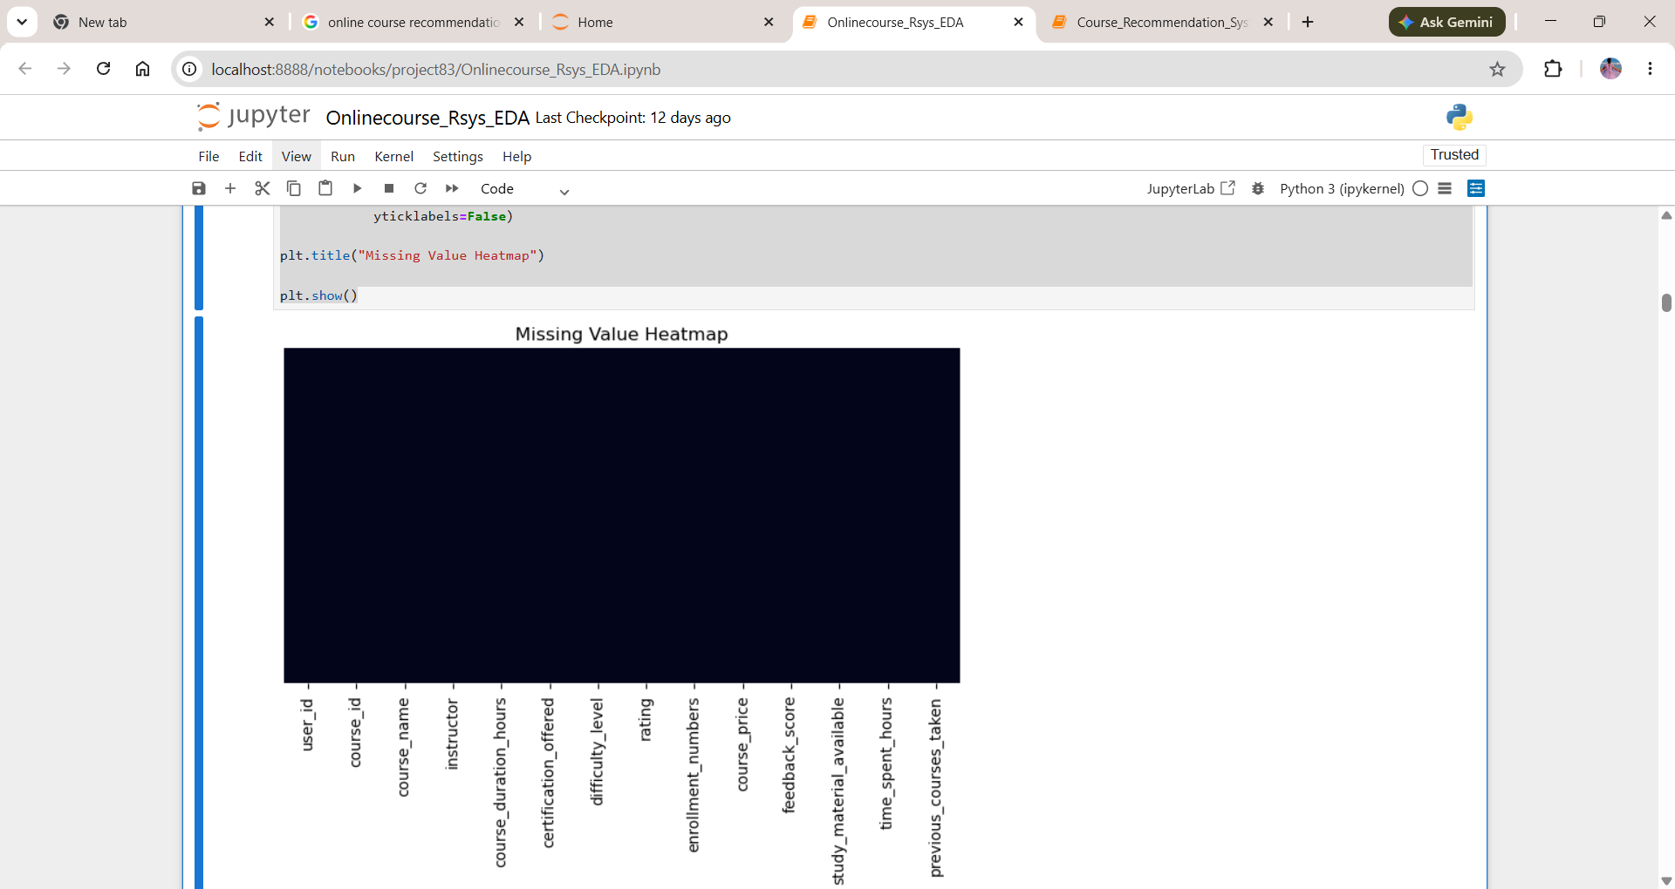
Data cleaning
plt.figure(figsize=(8,4))
sns.heatmap(df.isnull(),
cbar=False,
yticklabels=False)
plt.title("Missing Value Heatmap")
plt.show()
Output:
Here we can see no null values

Slide 8
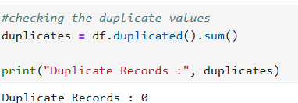
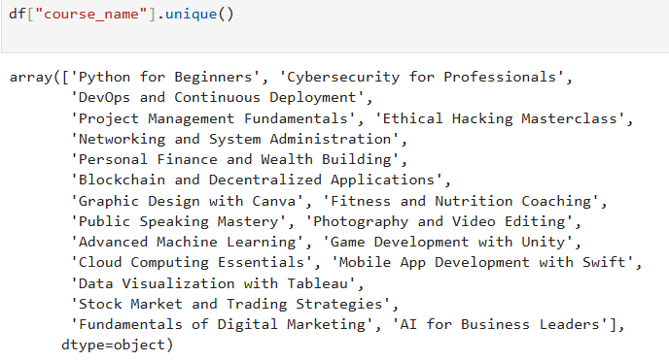
Checking duplicates
Unique Course Names:
The below code shows 20 unique course names
The above code describe :
Zero(0) Duplicate records

Slide 9
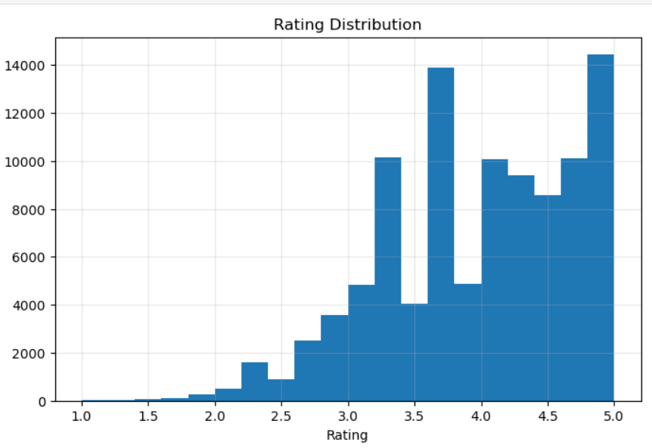
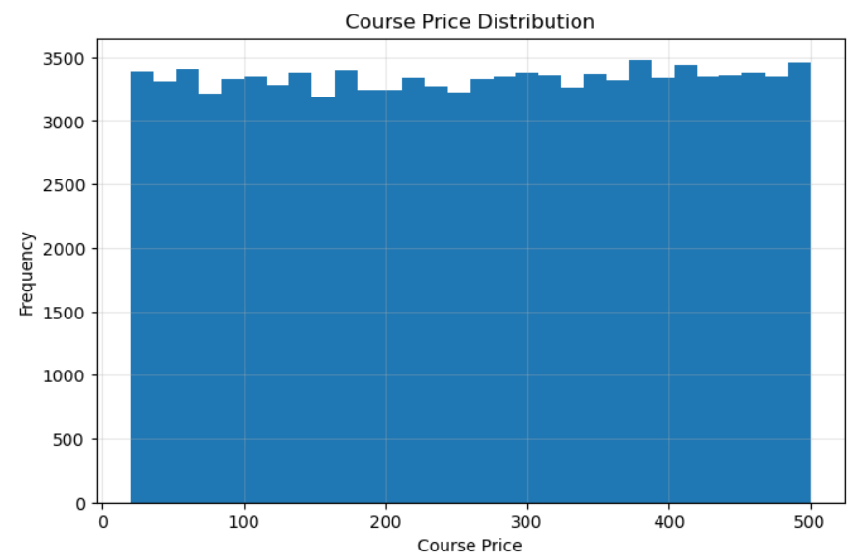
Visualization
Interpretation Rating Distribution The majority of courses are concentrated in the higher rating range, indicating positive learner satisfaction. Most ratings are between 3.5 and 5.0 Course price Distribution The platform contains courses across different price ranges, indicating that learners have multiple affordability options. Price can be used as a recommendation filter based on learner budget
Course Analysis:
Rating Distribution . Course price Distribution

Slide 10
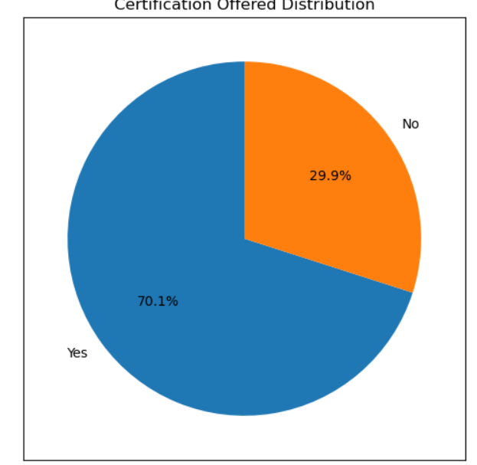
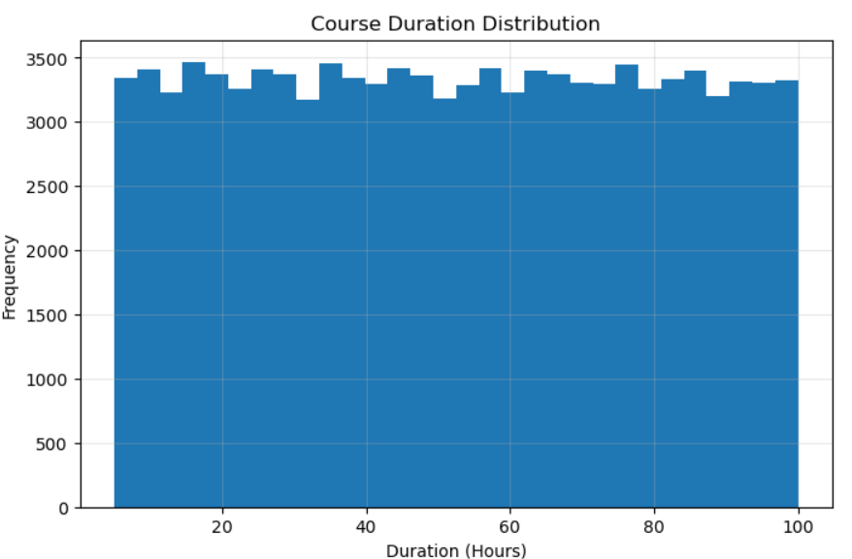
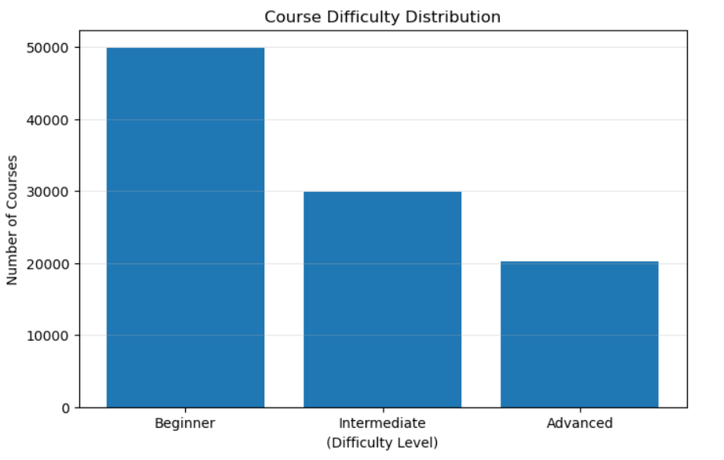
Course Duration . Difficulty Level . Certification Offered
Interpretation: Course Duration Course durations vary significantly, providing learners with both short-term and long-term learning options.Duration helps recommend courses according to learner availability. Difficulty Level Beginner and intermediate courses dominate the platform. Certification Offered A large percentage of courses provide certification. Certification becomes an additional recommendation preference

Slide 11
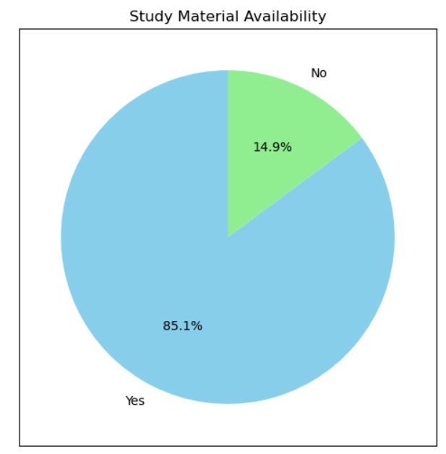
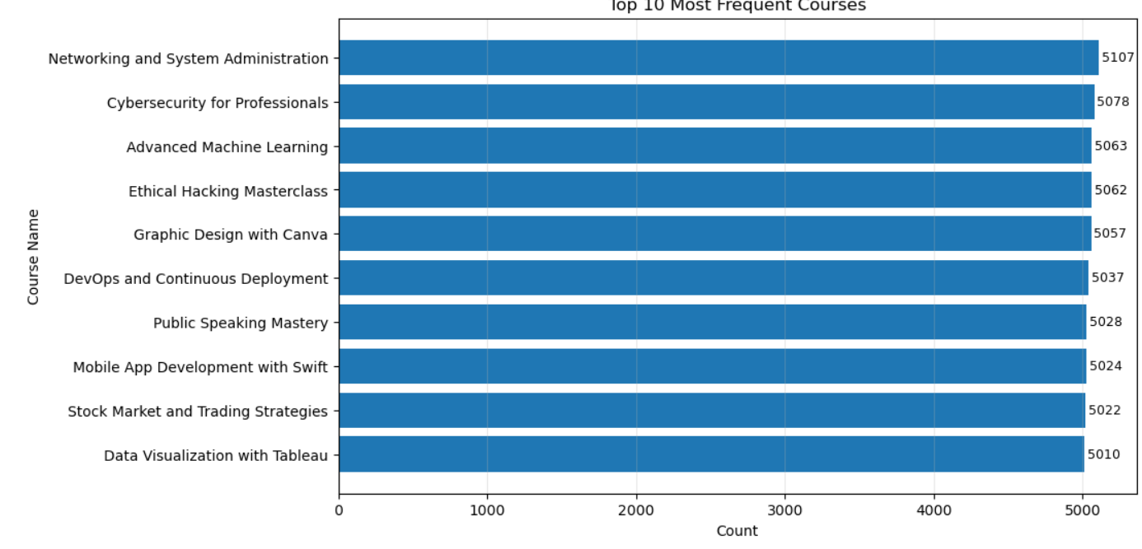
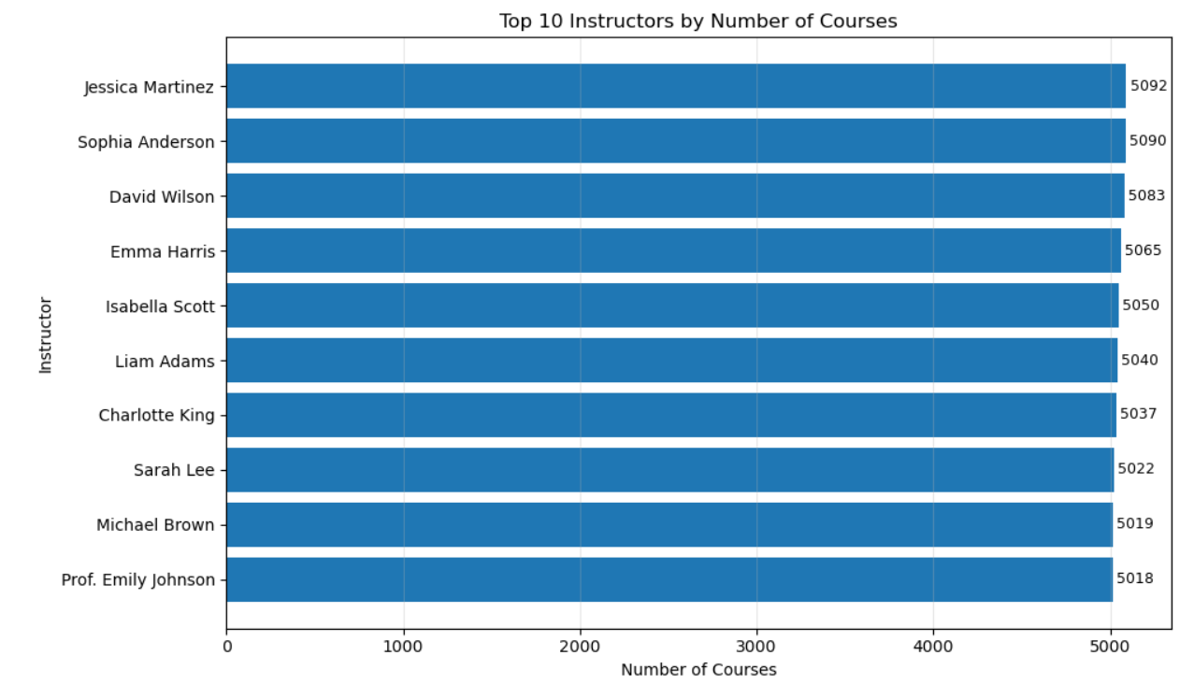
Study Material Available . Top Courses . Top Instructors
Interpretation: Study Material Available Most courses provide study materials,Study material availability enhances recommendation quality. Top Courses Certain courses consistently appear at the top.These courses are strong recommendation candidates Top Instructors A few instructors contribute many popular courses.Instructor information can improve recommendation quality.

Slide 12

Model building
Content-Based Filtering
Combined course-related features into a single text representation.
Applied TF-IDF Vectorization to convert text into numerical vectors.
Calculated Cosine Similarity between courses.
Interpretation: Courses with similar content receive higher similarity scores. If a learner likes one course, the system recommends other courses with similar features.

Slide 13
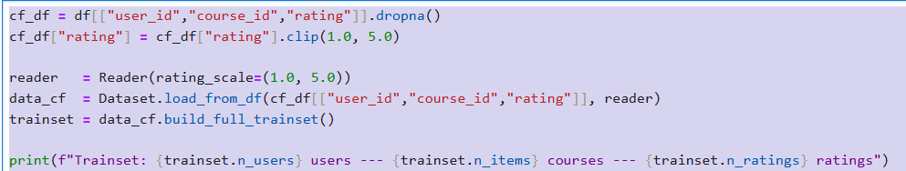
Collaborative Filtering
Created a User–Course interaction matrix.
Used the SVD (Singular Value Decomposition) algorithm from the Surprise library.
Trained the model using user ratings.
Interpretation: The model learns user preferences from historical ratings and predicts how much a user is likely to enjoy a course they have not yet taken.
CF scores ready for 9998 courses. Top 5 by CF score: [(8086, np.float64(4.57618773702952)), (8646, np.float64(4.570237453668733)), (6014, np.float64(4.558036832571766)), (2930, np.float64(4.54738131587234)), (3861, np.float64(4.541719628939642))]

Slide 14
Hybrid Recommendation Model
The Hybrid Model combines both approaches for better accuracy.
The final recommendation score is calculated as:
Final Score=α×Content Score+(1−α)×Collaborative Score\text{Final Score} = \alpha \times \text{Content Score} + (1-\alpha) \times \text{Collaborative Score}Final Score=α×Content Score+(1−α)×Collaborative Score
where:
α = Weight assigned to the Content-Based model
1 − α = Weight assigned to the Collaborative Filtering model
For new users with limited history, the system increases the content-based weight to overcome the cold-start problem.
Interpretation: The hybrid approach combines the strengths of both methods, resulting in more accurate and personalized recommendations.

Slide 15
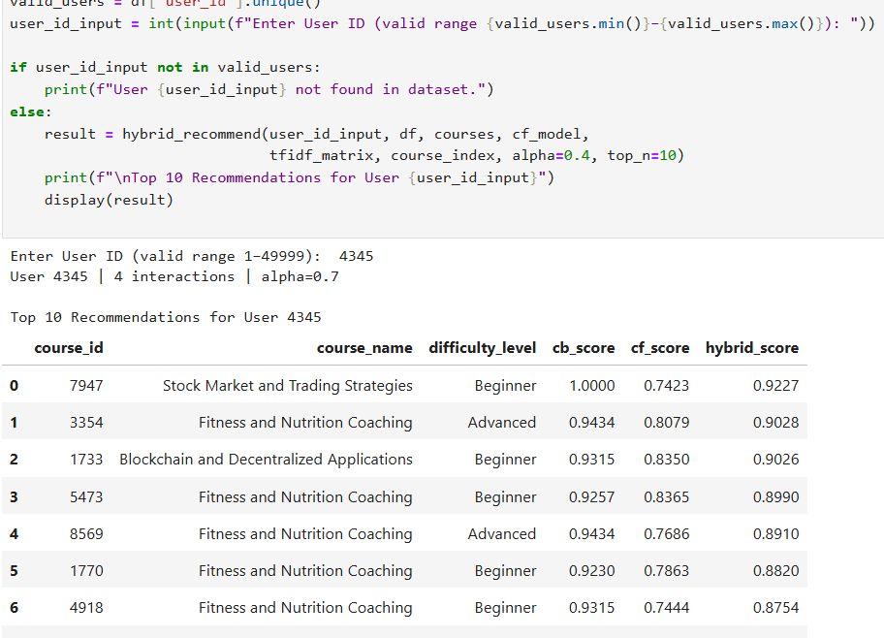

Model evaluation
The collaborative filtering model was evaluated using RMSE and MAE to measure prediction accuracy. Lower values of both metrics indicate that the predicted ratings are close to the actual user ratings. The hybrid recommendation system combines collaborative filtering with content-based filtering, helping improve personalization while also addressing the cold-start problem. Overall, the evaluation shows that the recommendation system can generate reliable and relevant course suggestions for users.

Slide 16
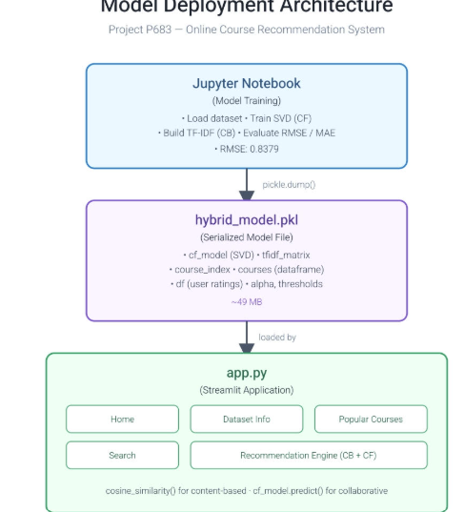
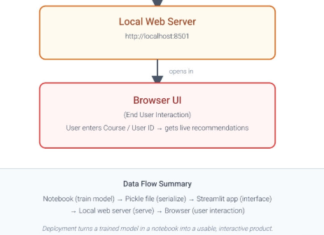

Model deployment architecture

Slide 17

Streamlit deployment

Slide 18
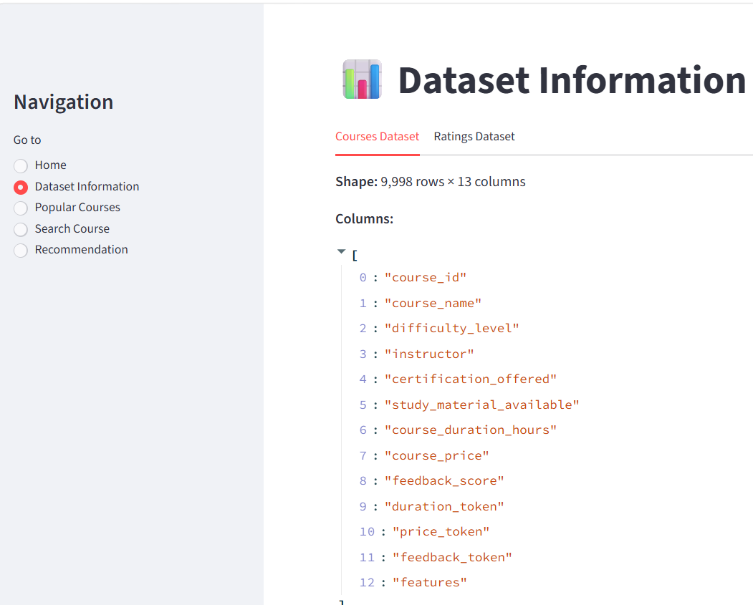
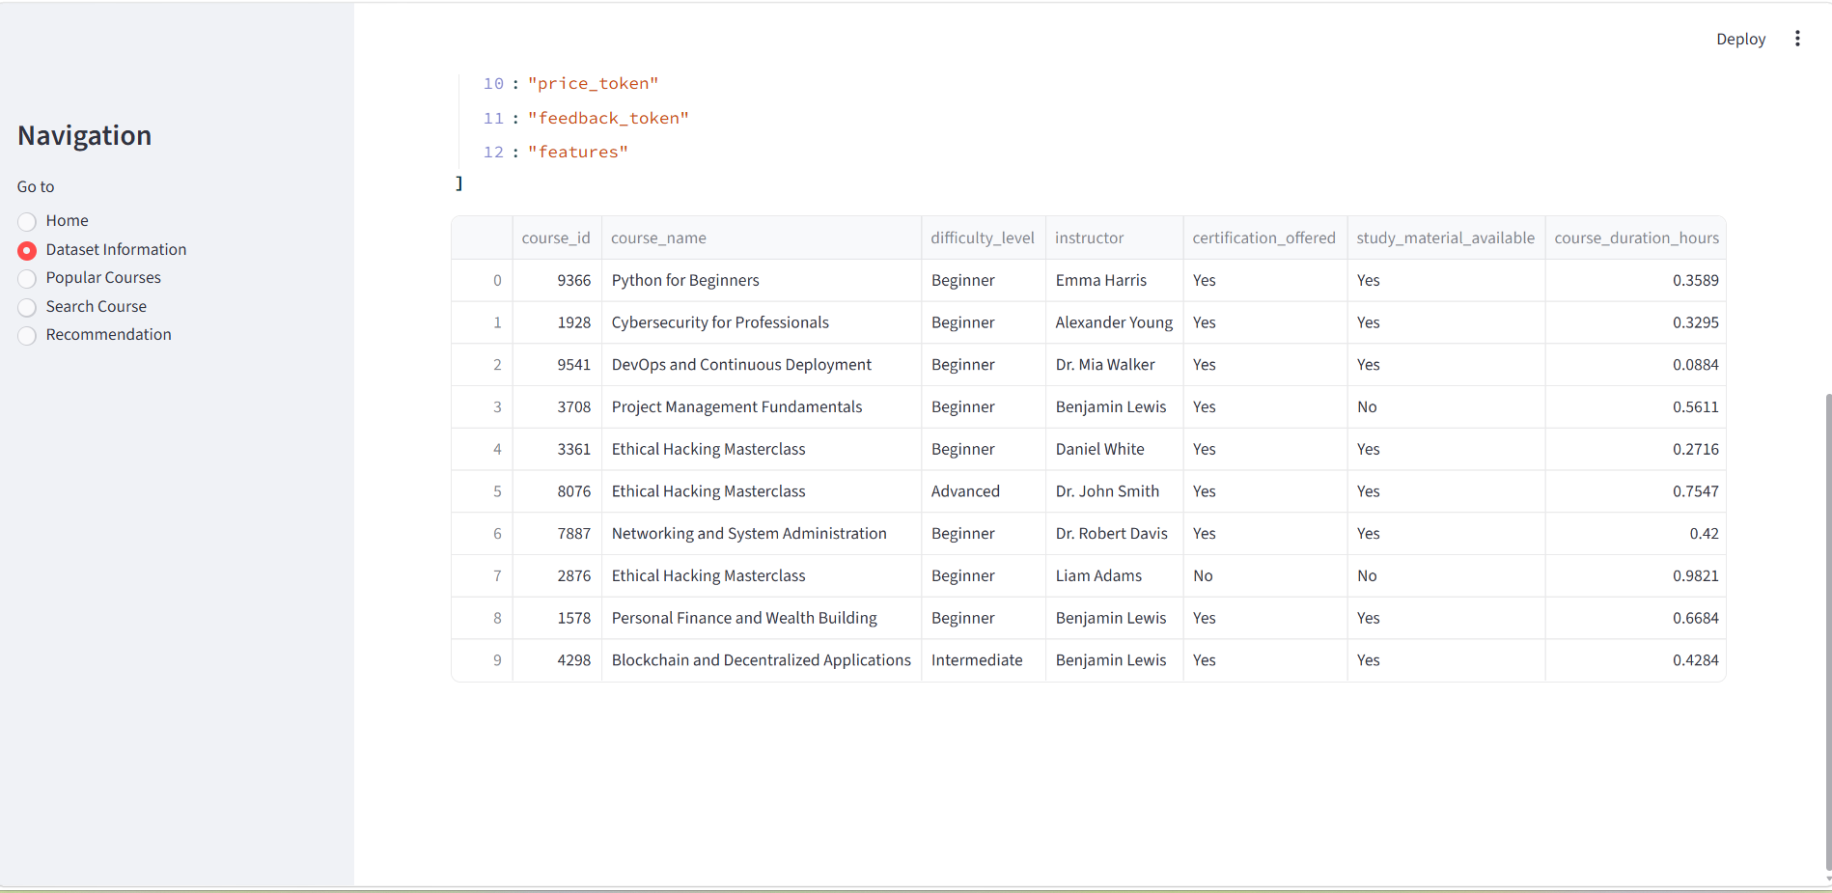

Slide 19
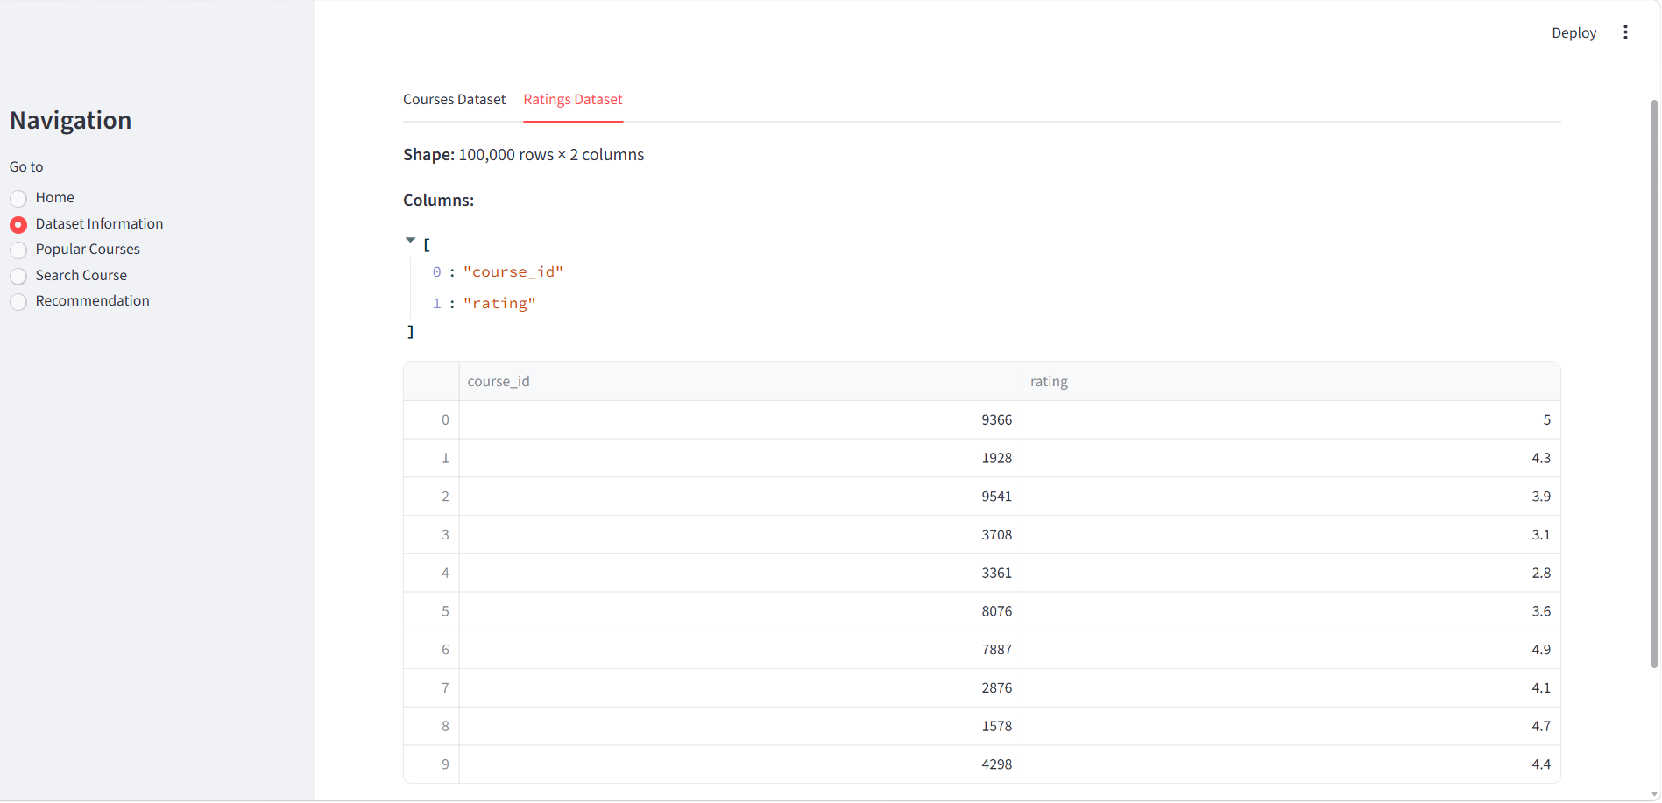

Slide 20
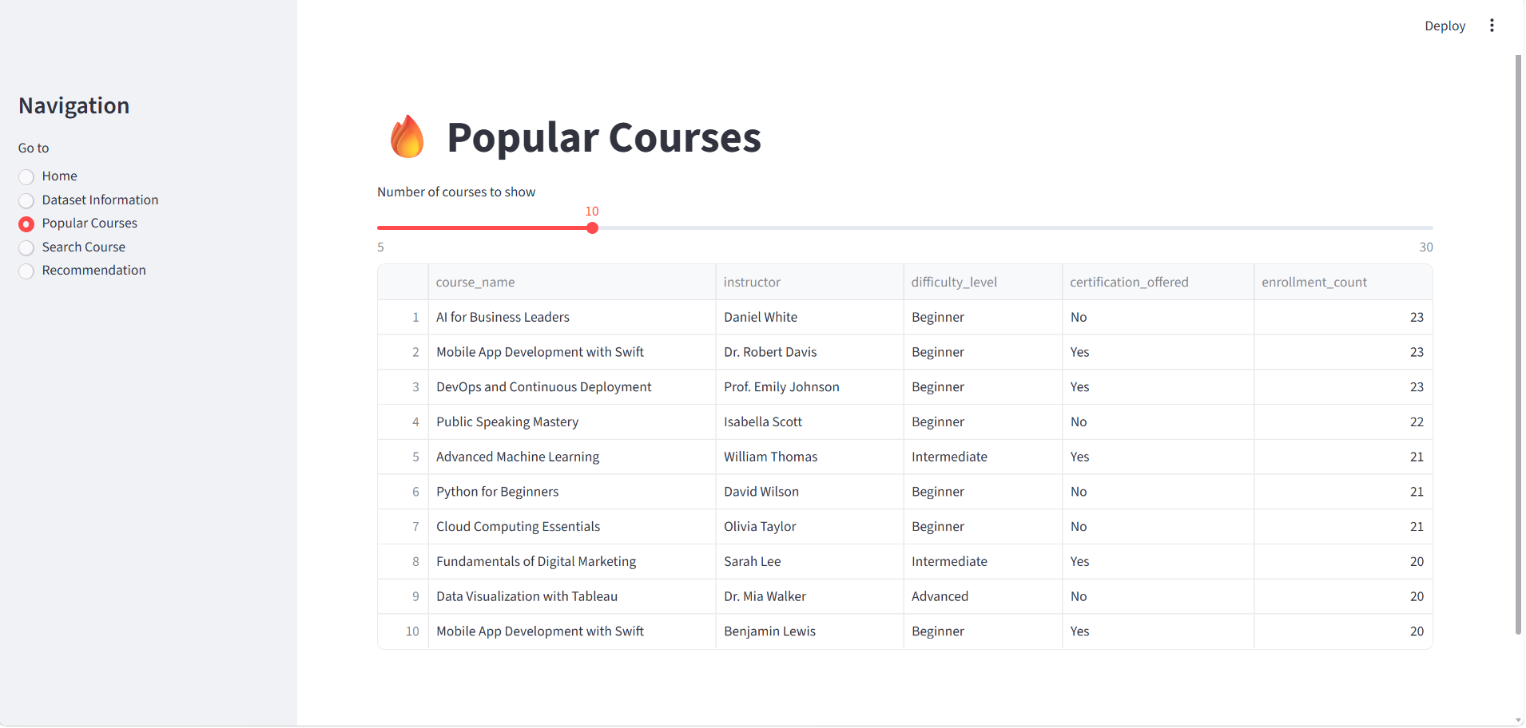

Slide 21
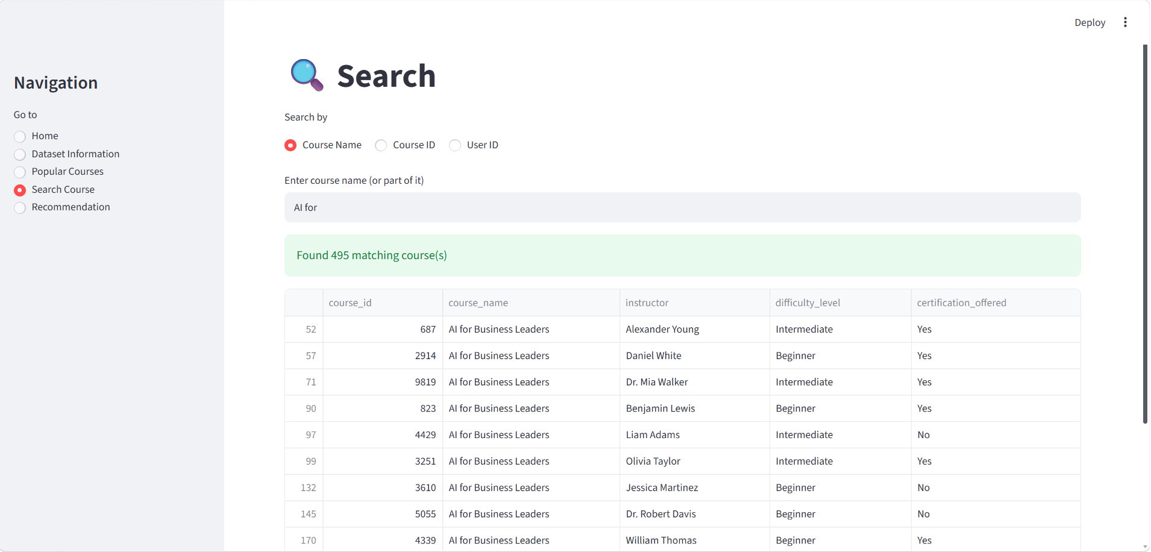

Slide 22
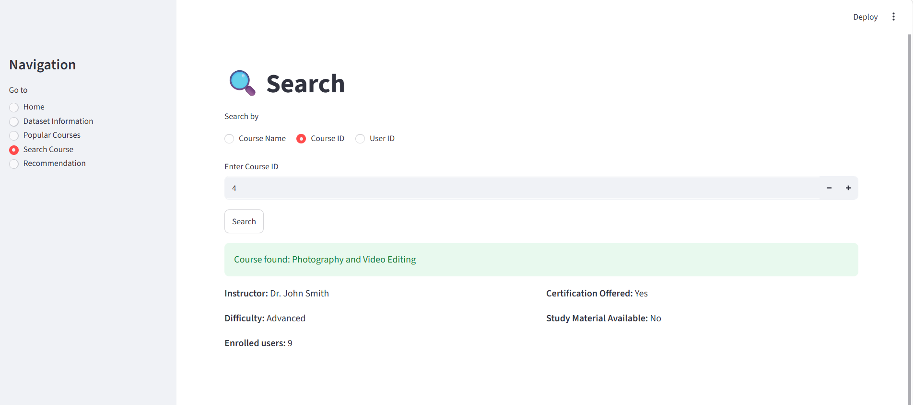
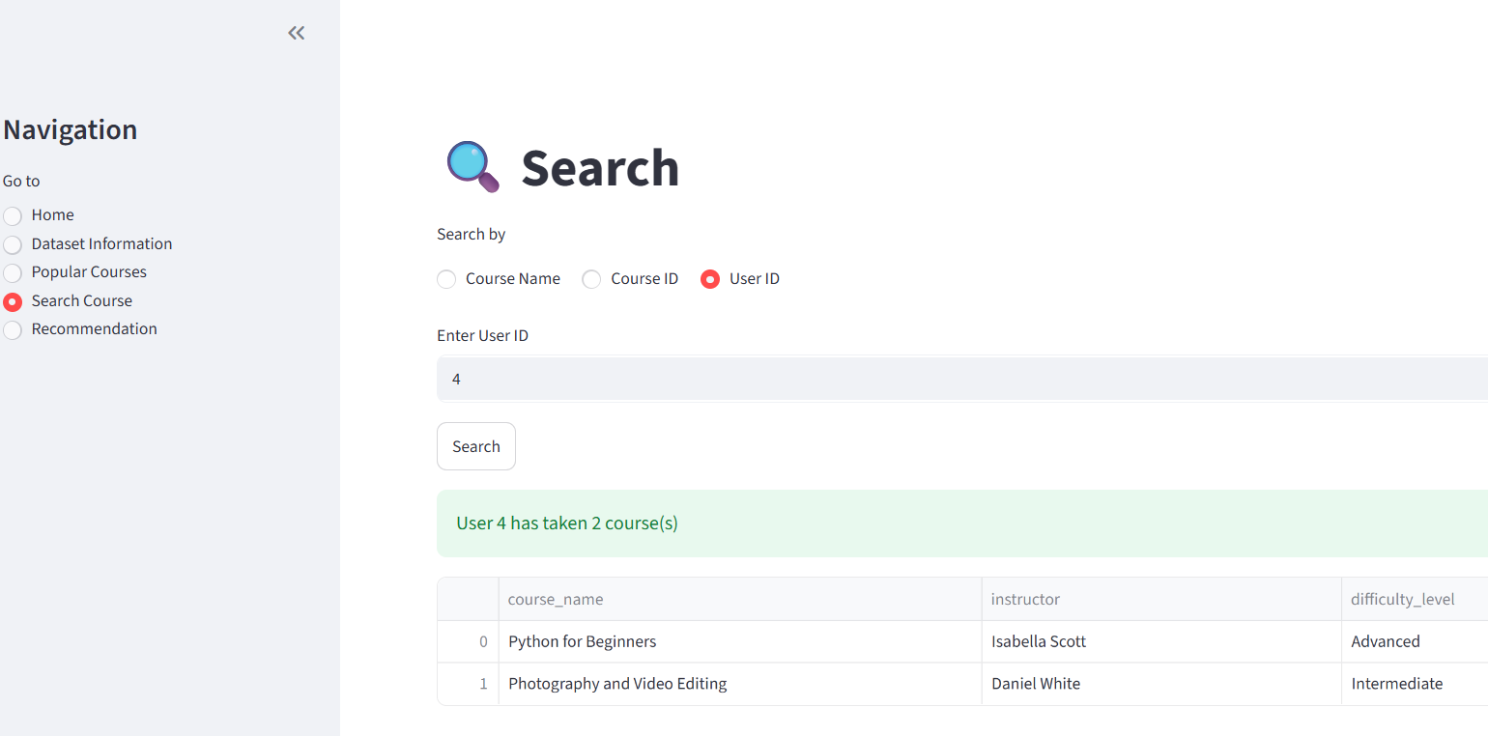

Slide 23
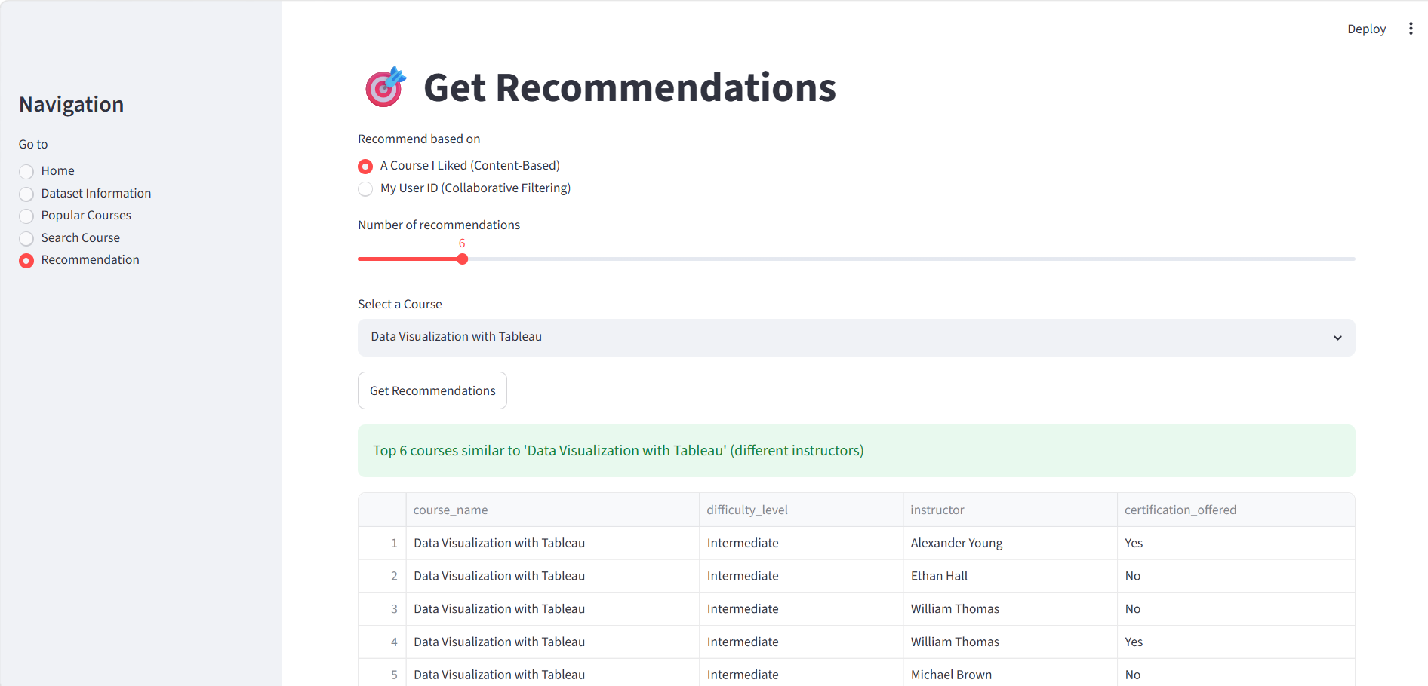
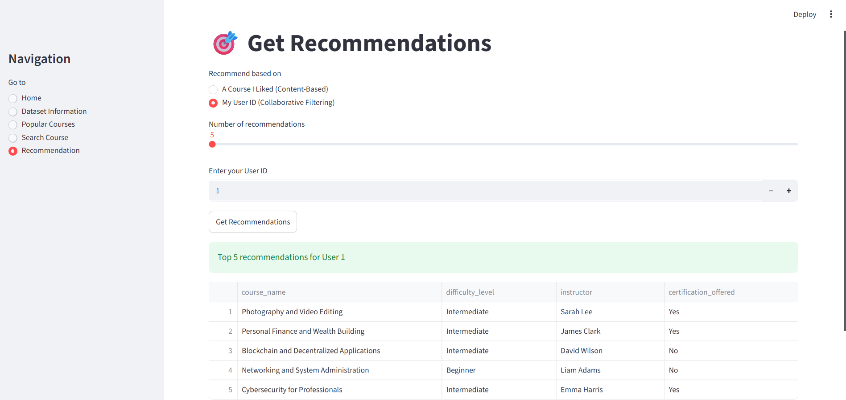

Slide 24
Challenges and conclusion
Challenges
Cold-Start Problem: New users or newly added courses have little or no interaction history, making it difficult to generate highly personalized recommendations.
Data Sparsity: Many users rate or enroll in only a small number of courses, resulting in a sparse user–course interaction matrix.
Scalability: As the number of users and courses grows, training and generating recommendations require more computational resources.
Conclusion
Developed a Hybrid Course Recommendation System using Content-Based and Collaborative Filtering.
Generated personalized recommendations based on user preferences and course features.
Improved recommendation accuracy and reduced the cold-start problem.
Evaluated the model using RMSE and MAE to assess prediction performance.
Successfully deployed the model using Streamlit for an interactive user experience.
The system enables learners to find suitable courses quickly and supports better learning decisions.

Slide 25
Thank you

